Slide 1
Make some noise and generate terrain
Michael McHugh

Slide 2
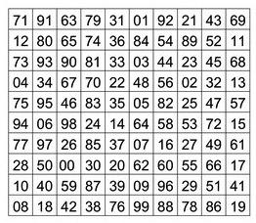
We’ll use a heightmap for our terrain
Notes:
For our purposes, we will be using a height map to represent the terrain. This is a simple model, but works quite well for many cases. A height map is a 2 dimensional array, with each cell representing the height at that co-ordinate. We can render a height map as 2d, top down view, where dark areas are low points, and bright areas are high points. This can be useful to see patterns and for quick glances, but I personally prefer to see a 3d render, because it looks cooler to me.

Slide 3
Generate a height value for point in the map
for x in width: for y in height: map[x][y] = value(x, y)
Notes:
The create our height map, it is a matter of iterating over every co-ordinate, passing in the co-ordinate to our value generating function, and storing the result.

Slide 4
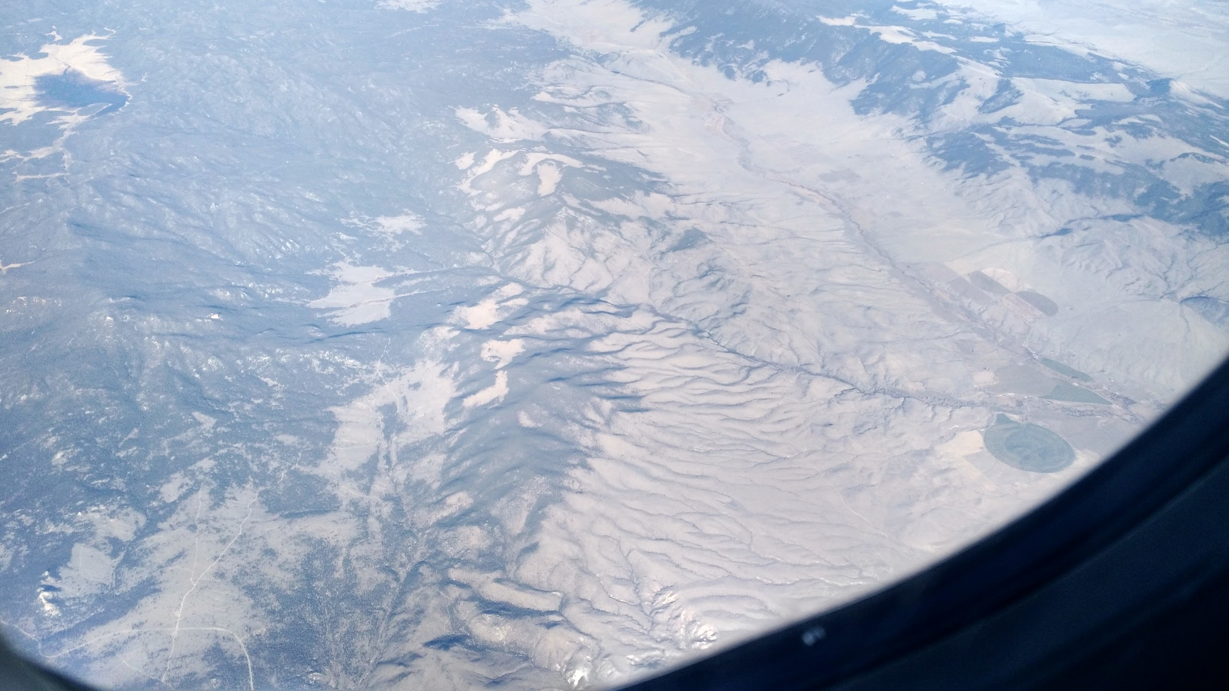
All of the interesting stuff is in the value function
Notes:
Of course, generating the map representation of the terrain is not too hard, but all of the fun and complexity comes out of that value function. That function is the focus of this talk, and I hope by the end of it, you will be able to understand how to generate interesting values for your own height maps, and even more importantly, that you feel that you can and will make your own! It gets pretty exhilarating to watch a world form before your eyes.

Slide 5

So what is noise?
Notes:
The title of this talk is about making noise, so what do I mean by noise? I’m not refering to audio signals, but it’s the errors in transmission that makes analog systems hard. If you’ve seen a TV displaying a bunch of static, that static is the noise on the channel’s signal. You may have heard the term “signal-to-noise” ratio, and how in most cases we want to get as much signal through and as little noise as possible. There are whole fields of signal processing that spend a lot of effort to remove this noise, because it’s messy and makes digital systems hard to work with.

Slide 6
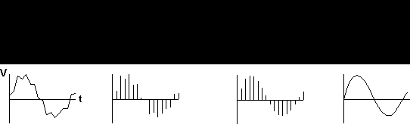
Without noise, data looks sterile and manufactured
Notes:
However! We are trying to generate natural looking things, and we _need_ that noise. It’s what makes things look and feel real, without it everything looks fake, sterile and machine generated. What we’re doing, of course, IS machine generated, but our goal is to make it so nobody can tell.

Slide 7
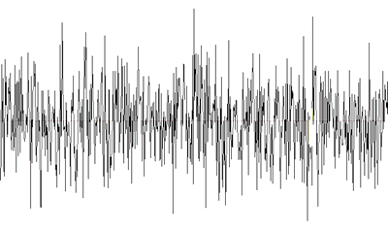
We don’t need the signal, just the noise
Notes:
Luckily for us, we don’t need to generate a signal and then disrupt it to make it noisy. We can just take the noise, and with some proper grooming and tweaking, that noise gets us close enough to what we want that nobody really knows the difference. And it’s a lot easier, and if there’s one thing I’ve learned about procedural content generation, it’s that everything is made of shortcuts. It really is all smoke and mirrors, but we’re going to shine a light on it.

Slide 8
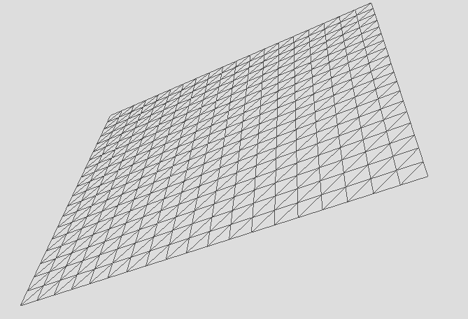
What’re the simplest values we could make?
def simple_height(x, y): return x + y
Notes:
So, we need to start generating those values for our height map, and probably the simplest thing we can do is just add the X and Y values together and set that as the value. However, as we can see this is really, really boring. It creates a perfect flat plane with no interesting features, so we need to introduce something else to make things a bit messy.

Slide 9
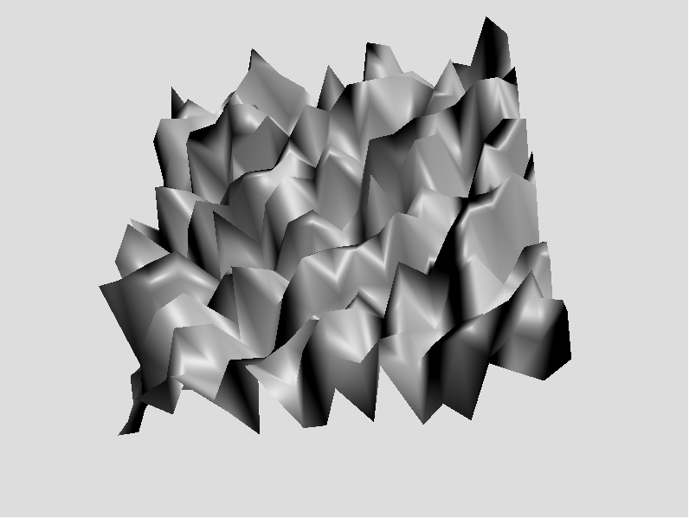
How does it look with some randomness?
def all_random(x, y): return random.random()
Notes:
How about instead of summing them up, we generate a random value from a uniform distribution. Again we loop over the image, and for each spot just choose a random height between 0 and 1 and use that. This certainly looks… interesting. But it is _too_ messy. The flat plan was boring, but this is just as bad.

Slide 10
Neither of these look very realistic
Notes:
Both of these look bad for their own reason, and we’re not convincing anyone that this is what an actual piece of terrain looks like. But both for separate reasons, so if we can figure out what the good parts of each are, we can find something that works better.

Slide 11

We want random changes that happen gradually
Notes:
When dealing with noise, the change between any two distant points should be completely random, otherwise we will see patterns and get bored. But if we have 2 points which are very close to each other the change between them should be small. Said another way: nearby points should produce similar values, distant points should produce arbitrarily different values. We call this “coherent noise”

Slide 12
A sine wave is a coherent function
Notes:
Sine waves actually have all the properties we want. The points in blue are close with very small changes in their value. All the red lines cover the same amount of change in the x axis, but all have very different changes in the y, and the changes are continuous and don’t cause visual breaks.

Slide 13
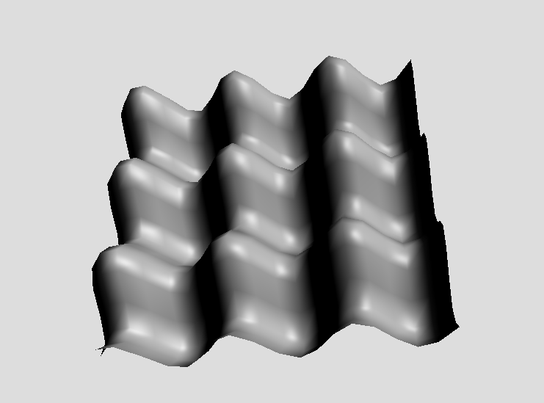
Sine waves aren’t noisy, though
Notes:
Unfortunately sine waves are more like the signal we talked about before, what we’re typically looking at after removing all the noise. However, if we take multiple sine waves and offset them by a random amount, then sum them all up, it starts to get noisy enough

Slide 14
When combining waves, we have options
Octaves
Frequency
Amplitude
Notes:
We have a few parameters we can change to alter the way our output looks, and this is a taste of what procedural generation is about. We will tweak and observe the parameters to ensure the output that is generated conforms to our constraints, guiding the functions to create what we are looking for. Borrowing terms from sound waves, the number of octaves is how many waves you want to combine into one. The frequency is how quickly each wave oscillates between high and low, and the amplitude is how large the wave is at it’s high and low points. Typically each octave would have different frequency and amplitudes.

Slide 15
Let’s design our sine wave based noise now
for n in range(number_of_octaves): parameters.append({ 'offset': random.random() * 2 * math.pi, 'frequency': 2**n, 'amplitude': start_amplitude / float(n+1), })
Notes:
First we will calculate the parameters for each individual wave. Each octave will double the frequency of the previous octave (which is also how octaves are defined in music), calculated by raising 2 to the Nth power for the Nth octave, and to make the higher frequency waves contribute less to the overall total, we will divide the amplitude by N in each wave.

Slide 16
Use those parameters to generate output
for p in parameters:
offset = math.sin( x * p['frequency'] * 2 * math.pi + p['offset'] )
output += math.sin( y * p['frequency'] * 2 * math.pi + offset ) * p['amplitude']
Notes:
Now that we have calculated the parameters for each of our constituent waves, we will calculate the final output. Since a sine wave is a 1 dimensional function, so it only takes one input, and we have 2 inputs, we will first run the x value through, and we will take the output of that and use it as the offset when we run the Y part through. This will keep things coherent, while still providing enough randomness to look all right.

Slide 17
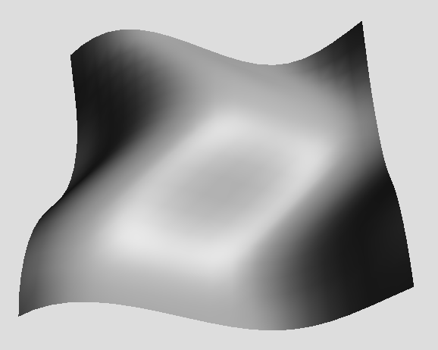
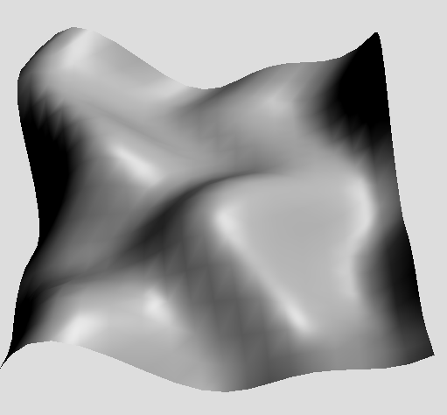
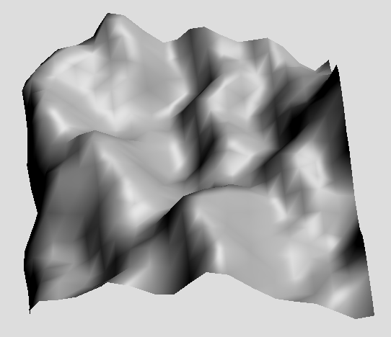
We can now try different octave counts and observe
One octave Two Octaves Three Octaves
Notes:
The first, low frequency but high amplitude wave sets the rolling stage, but the higher frequencies come in and add more and more detail to the terrain, making it look less manufactured and more interesting

Slide 18
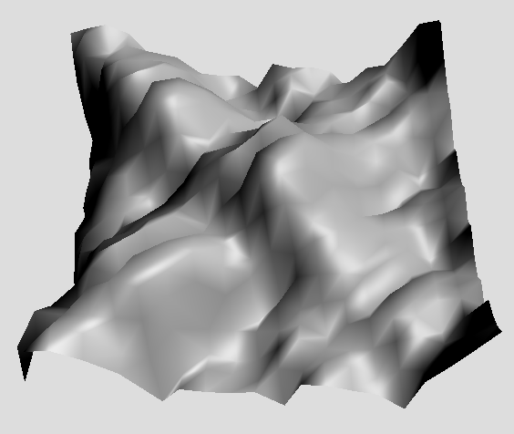
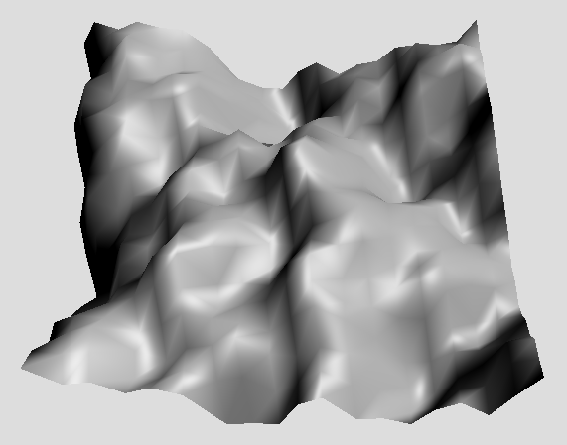
Unfortunately, the sine wave shows it simplicity
Six Octaves
Eight Octaves
Notes:
As we add more than a few octaves though, we start to see clear patterns emerging. This is because the sine wave has a very clear pattern, and the harmonics start to line up, despite the phase shifting of each wave. But don’t despair, this as an illustrative example but not intended to be final.

Slide 19
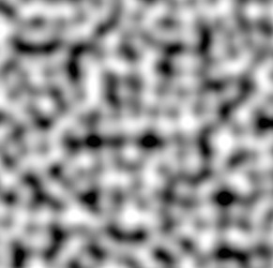
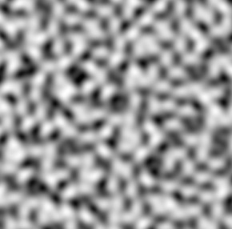
Better, more useful equations have been designed
“Classic” Perlin
Simplex
Notes:
Noise generation is a thing that’s been around for a while in computers, with Ken Perlin creating his classic noise algorithm in 1985, for which he won an academy award, as this noise was used in creating textures for the CG film industry. It, like most things in computers, had flaws and drawbacks, the primary one being that features end up being fairly axis aligned. So he then created Simplex noise which is more complicated but avoided some of classic Perlin Noise’s problems.

Slide 20
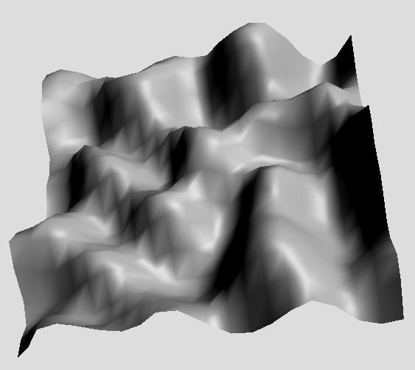
Using OpenSimplex, the artifacts disappear
tmp = OpenSimplex(12345) def simplex(x, y): return (tmp.noise2d(x, y))
Notes:
We won’t be using either of those, though, because of the drawbacks of perlin noise and patent issues with simplex. I don’t think that most people will actually have issues with the patent as it covers very specific use cases, but a fellow by the name Kurt Spencer made OpenSimplex in 2014 so we can use that and not worry. This looks much better than our previous sine wave attempts, but we don’t have the same kind of tuning parameters that we did in our sine wave examples. We just provide a vector (in this case, 2d, though OpenSimplex scales to as many dimensions as desired, 3 and 4 are also common) so we will need to find new ways to adjust the output to our liking

Slide 21
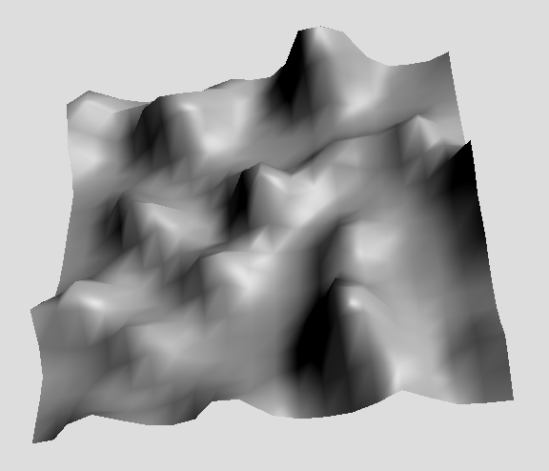
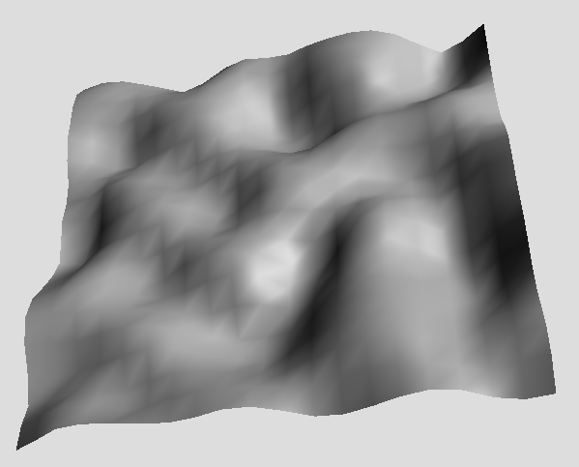
Alter the output by using filters
4th power
4th root
Notes:
One way to alter and mold your creation is to pass the output of your noise function into a filter to modify the value. One such filter is to raise the output to some power. When your output lies between 0 and 1, raising it to a fractional power, which is the same as calculating a root, will cause the low points to rise and high point to stay relatively close, removing valleys and smoothing out the terrain. If we raise it to an exponent >1 it will cause the contrast between valleys and peaks to become more exaggerated, as the valleys now drop much more quickly than the peaks.

Slide 22
There are many filters you can apply
OUTPUT
INPUT
Notes:
You can also use a curve map to translate your original output to a new output. The curve takes as input your value and maps it’s location on the curve to find the new output. This curve mapping is used to change the distribution, using an s curve will give us a lot of values that are either very low or very high, with not a lot in between producing plains and plateaus.

Slide 23
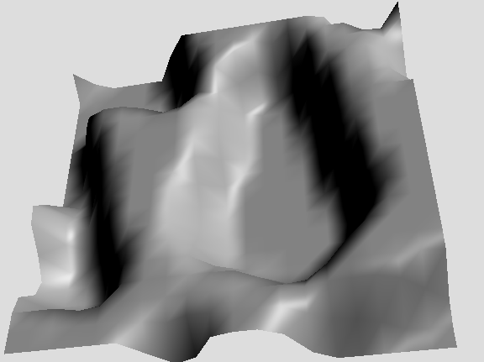
Create a curve we will use as an interpolation
def simple_curve(value): start = 0.4 end = 0.6 if value < start: return 0.0 if value > end: return 1.0 return (value - start) * (
1 / (end - start)
)
Notes:
In addition to using filters tt modify the output, you can also combine multiple sources of noise to combine to your own creation. This becomes particular potent when combined with filters. As an example, we will start by make a very simple curve. If the input is less than 0.4, return 0. If the value is greater than 0.6, return 1. For values in between, we will linearly interpolate.

Slide 24
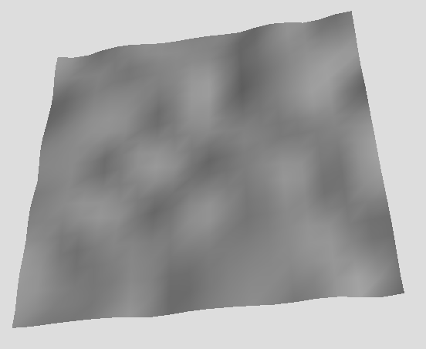
Create the first noise source, some rolling plains
def plains(x, y): value = (tmp.noise2d(x, y)) value = value**0.25 value = value - 0.6 return value
Notes:
The first of the 2 source noise functions we will use in our final output will be made to mimic rolling plains. To do this, we will apply 2 filters. First, we will apply the root filter, generating the 4th root to reduce the contrast between peaks and valleys, and then apply a scale filter to bring the values down to the lower end of the spectrum.

Slide 25
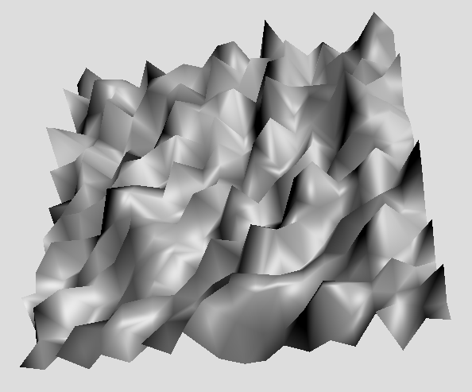
The second source, some mountains
def mountains(x, y): value = tmp.noise2d( x*6.0, y*3.0 ) return value * 2.0
Notes:
To generate some mountainous terrain, we will increase the frequency of the noise as we talked about earlier, and we do this by multiplying the input co-ordinates before passing it into the simplex noise function, making the noise change more quickly than it would otherwise. We then pass the output through a scalar filter multiplying the output by 2, so we double the contrast between valleys and peaks

Slide 26
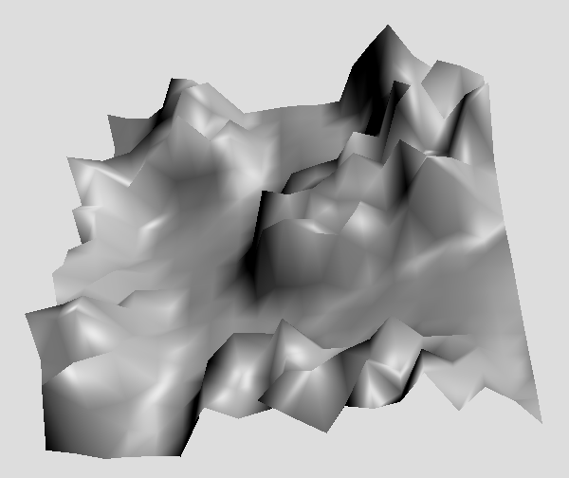
Pull them all together
def combined(x, y): m = mountains(x, y) p = plains(x, y) w = simple_curve(x, y) return (p * w) + (m * (1 - w))
Notes:
Using all 3 of the sources together, we get something which is much more interesting than any of the individual sources themselves. The final combination is formed by generating the value of the plains, the mountains, and our simple curve at every point. We then interpolate between the plains and the mountains use the curve as the weight.

Slide 27
This combination of filtering and mixing is the art
Colouring/Textures
Resource distribution
Biomes
Cave systems
Dungeon/Level design
Voronoi Diagrams
Ridged Multi-fractal
Marching Squares
Dual Contouring
Notes:
This concept of using multiple sources, filters and combinations might seem straightforward, or it might seem daunting, but this is really all there is to it. The more complicated systems and environments are just more layers of filters, and extra sources combined in novel ways. Once you understand how this works, and if I did my job you are well on your way to understanding, everything is open to you and you are free to build your own worlds. You can use noise to generate anything you want! Probably.

Slide 28
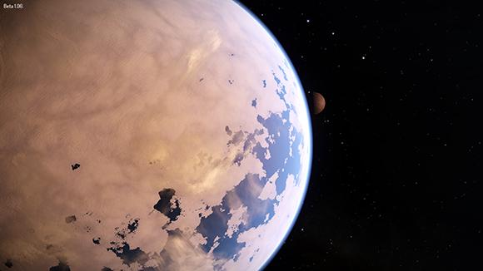
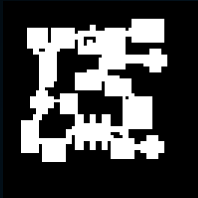
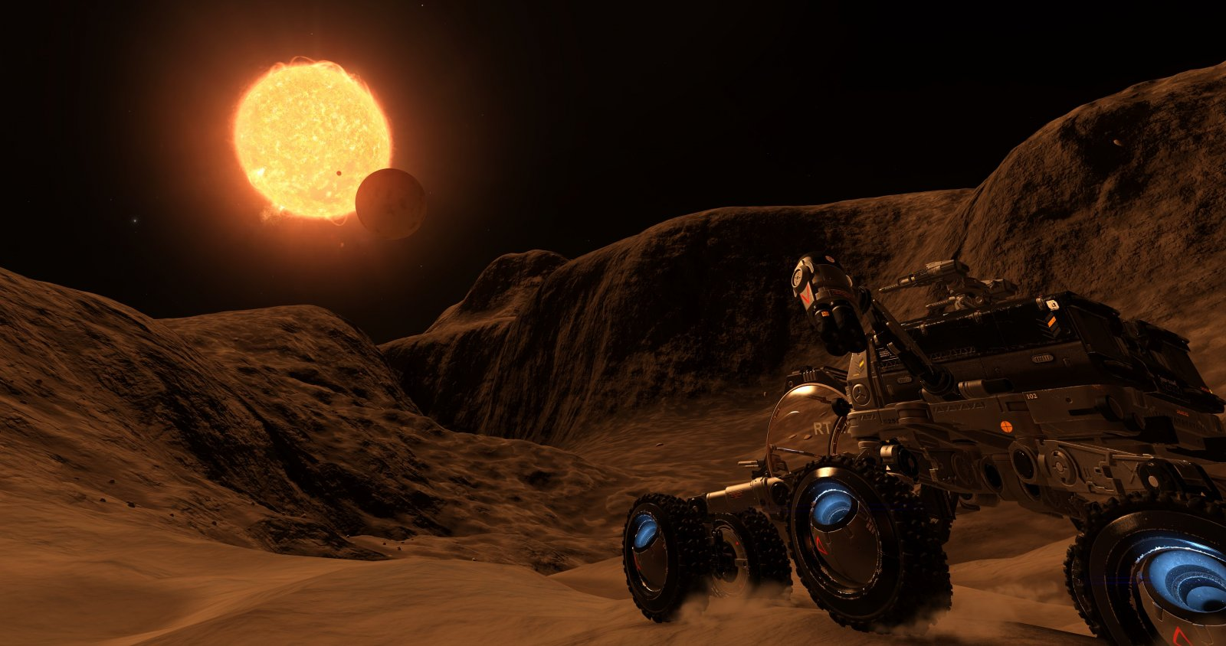
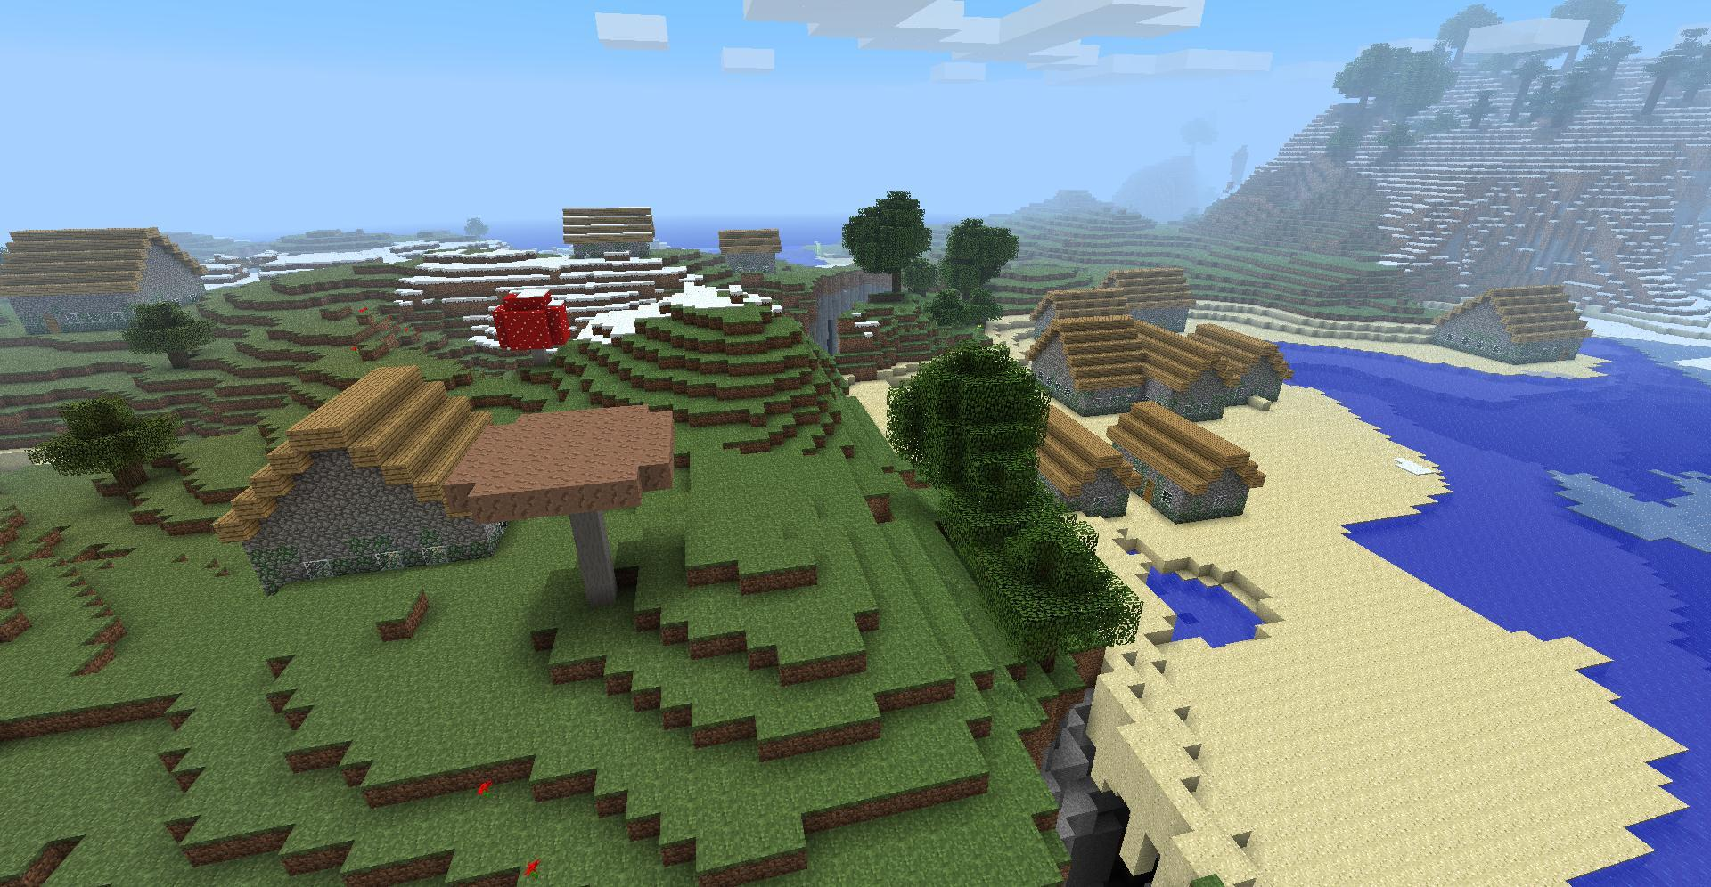
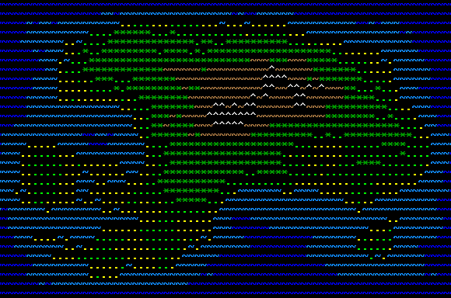
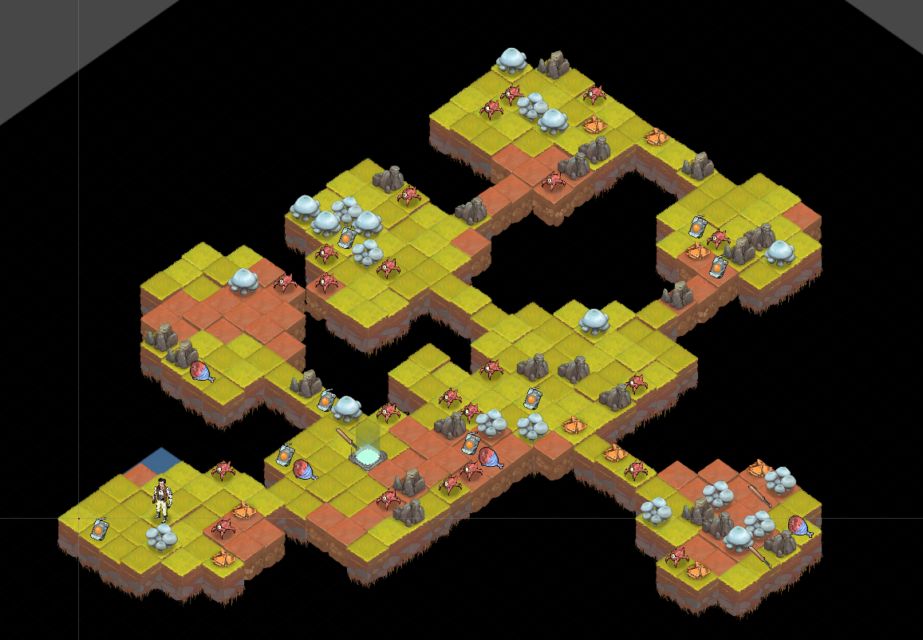
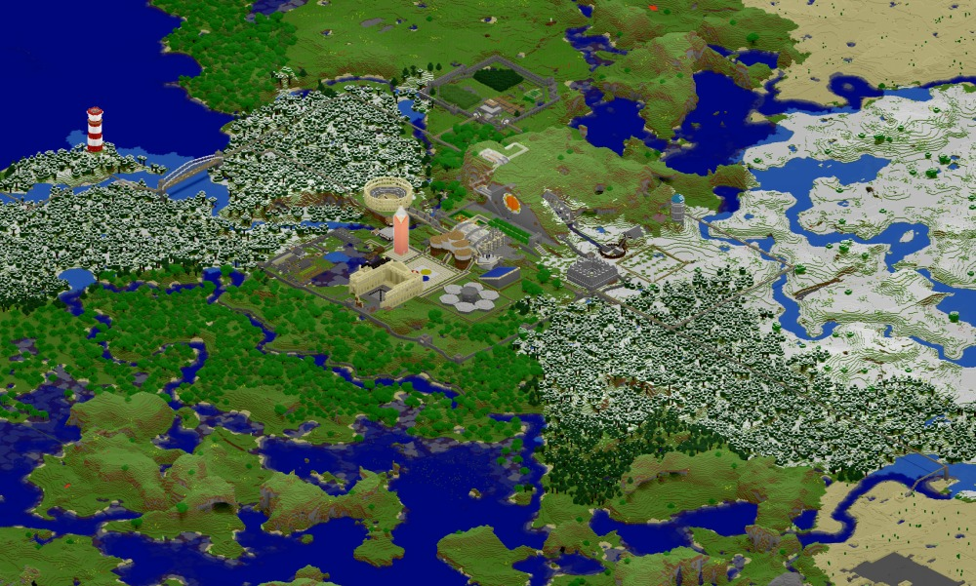
So, so much more to say
Notes:
This introduction barely scratched the surface of what you can do with procedural generation. I hope that it has scratched away enough of the surface layer to help you see into the depths below, and I really do hope you take what you’ve learned here and use it to go research other techniques and experiment for yourself!

Slide 29
Online things
github.com/mmchugh/pyconca_noise
@mmchugh
Notes:
I put the code I used to generate the images in the talk up online in github here. It’s got functions for generating all the noise I used, a little HTML page using three.js for the rendering and a flask app to facilitate communicating between the web renderer and the python noise generation code. Please do take a look and play with it yourself to see what you come up with, or even better, build something for yourself!

